Slide 1
KICKSTARTER PROJECT
- Success Prediction
Presented by:
Srikari Veerubhotla [015957032]
Prashansa Evangeline Bonapalle [016678324]

Slide 2
Motivation
Kickstarter is a popular crowdfunding platform that has helped to launch many successful creative projects.
However, not all projects are successful in reaching their funding goals, and this can lead to disappointment for both creators and backers.
Our motivation is to improve the success rate of Kickstarter projects by providing accurate predictions and insights to creators and backers.

Slide 3
Introduction
It is a model that classifies whether a project will be successful or not.
The model classifies based on various parameters such as goal, usd_pledged, category, backers_count etc.
The target variable is the ‘state’, which has categories such as, ‘successful’, ‘failed’, ‘live’, ‘suspended’, and ‘cancelled’.
This helps people decide on the parameters or the issues that have to be taken into account before starting a new project.

Slide 4
Problem Statement
The goal is to predict whether a Kickstarter project proposal will succeed or fail in achieving its fundraising goal based on information from the project launch.
This is a classification problem with binary output, and input features can include project category, funding goal, project duration, description and number of backers.

Slide 5
Outline
We can develop this kind of application using Classifier models.
There are multiple models that can be used to train on the dataset.
In our project, we have used Logistic Regression, Decision Tree Classifier and Gradient Boosting Decision Tree Classifier.
We have compared the performance of the 3 models, and have chosen the best one among them.

Slide 6
Methodology
Data Preprocessing
Exploratory Data Analysis
Training and Evaluation
Logistic Regression
Decision Trees classifier
Gradient Boosting Decision Tree classifier

Slide 7
Libraries Used
NLTK: For string tokenization.
Pandas: For accessing data frames and manipulating them.
Numpy: For matrix and array operations.
Matplotlib: For plotting graphs.
Seaborn: For correlation heatmap and plots.

Slide 8
Dataset
kickstarter_data_with_features.csv
(20632, 60)
This dataset contains information over variety of projects.
Some of them are: project type, launching date, deadline, country,....

Slide 9
Data Preprocessing
Replaced the null values.
Created new feature to calculate percentage of pledged/goal.
Extracted date, time, hour, minute, month and year from the deadline and created new features with them.
Dropped unrelated columns such as id, photo, blurb, disable communication etc. as they do not contribute to the state, which is our target.

Slide 10
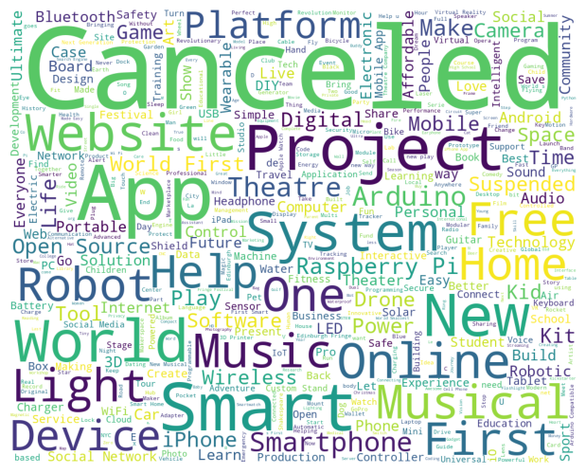
Data Preprocessing
We have used NLTK to tokenize the name.
Removed stop words from the text.
Calculated the word count, character count and average word length and appended these columns to the dataframe.

Slide 11
Data Preprocessing
Performed Encoding to change the categorical column to numerical.
Columns such as Category, State, Country and Currency were encoded to 0,1…
Performed Normalization to bring the columns to transform features to be on a similar scale.

Slide 12
Exploratory Data Analysis
Initially, the dataset contains 20632 rows and 60 columns.
The columns are of type integer, string and boolean.
Blurb, Location, Category , friends, is_starred, is_backing, permissions have null values.
Replaced the null values with 0.

Slide 13
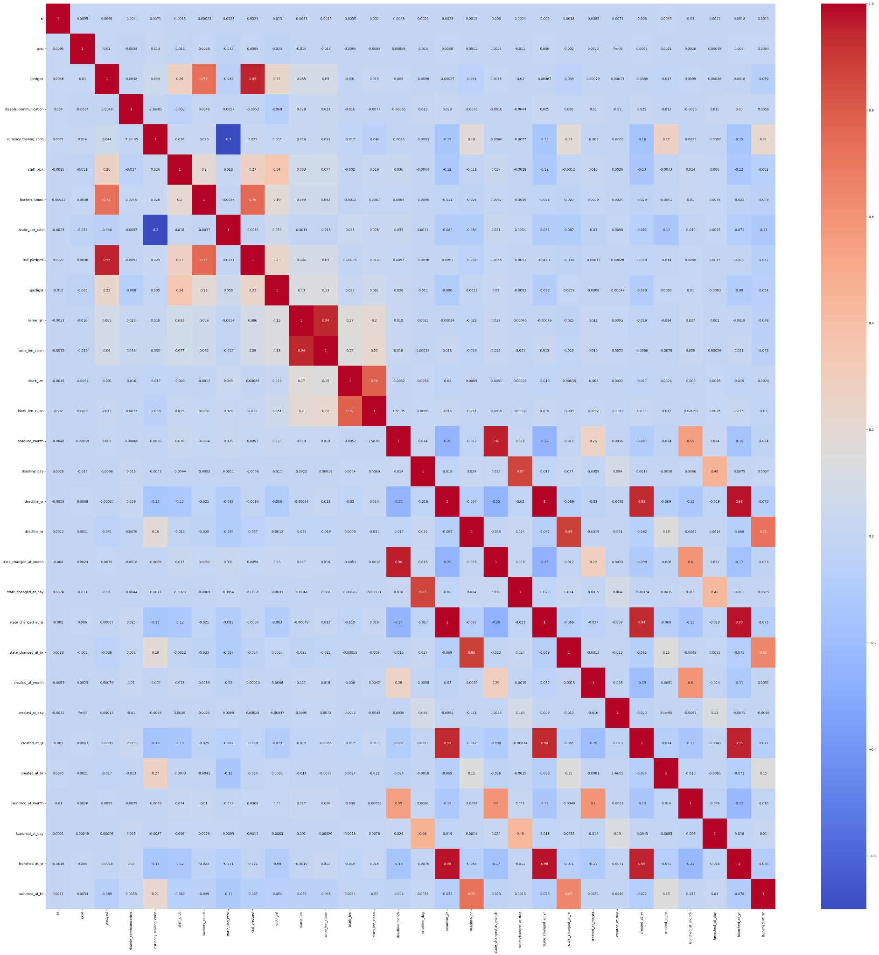
Correlation Matrix
We have plotted the Correlation Matrix for the dataset, to find the relationship between the columns.

Slide 14
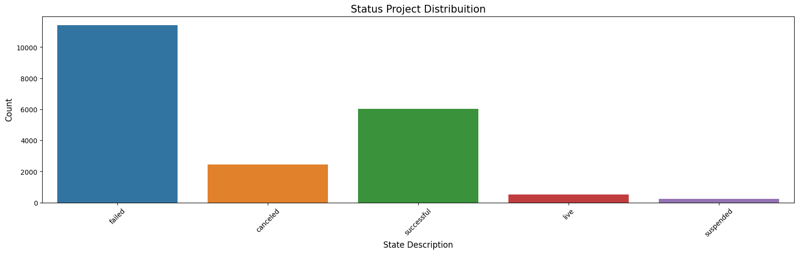
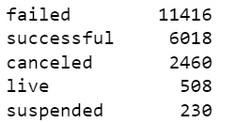
Count plot for “State”

Slide 15
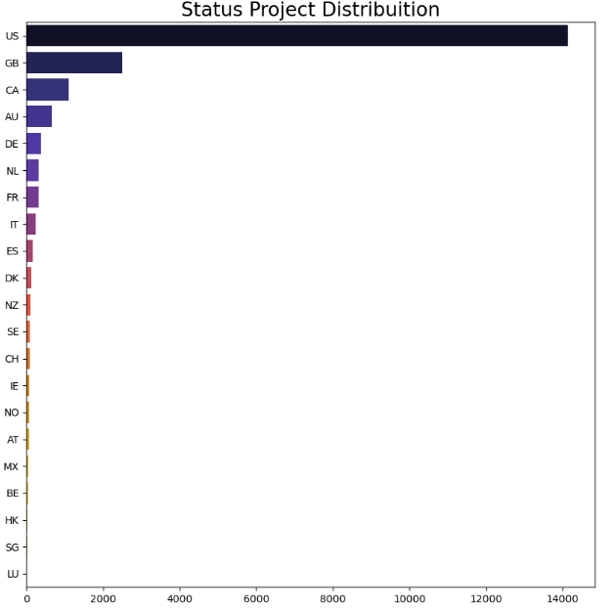
Count plot showing “country percentile”

Slide 16
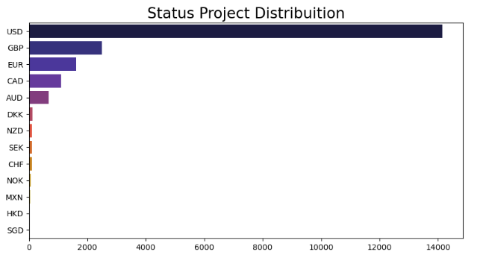
Count plot for “currency percentile”

Slide 17
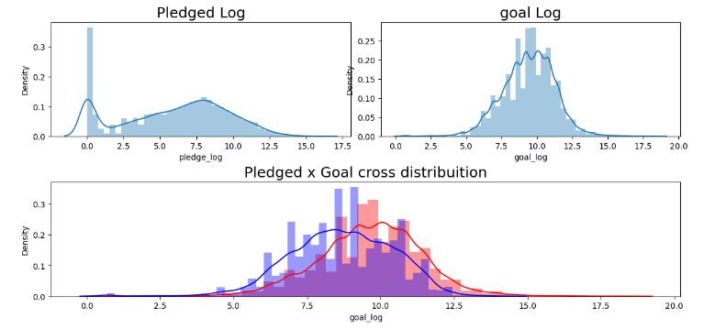
Understanding of goal & pledged in logarithmic

Slide 18
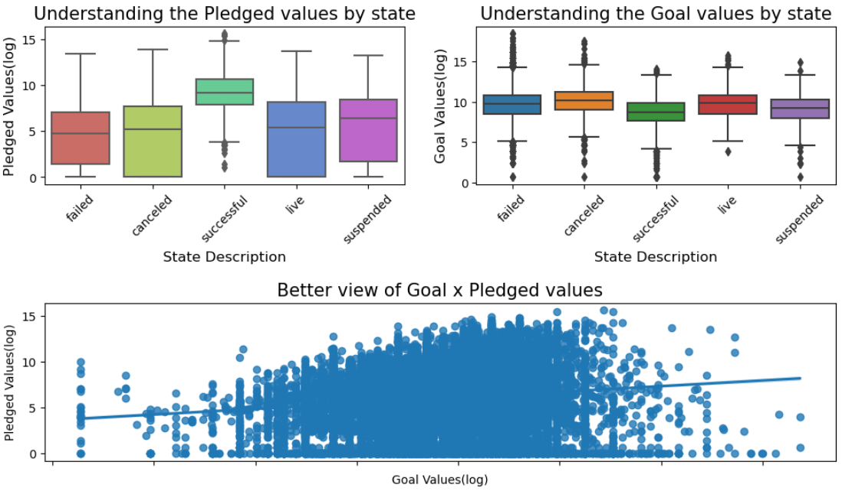
Goal and Pledged values by state

Slide 19
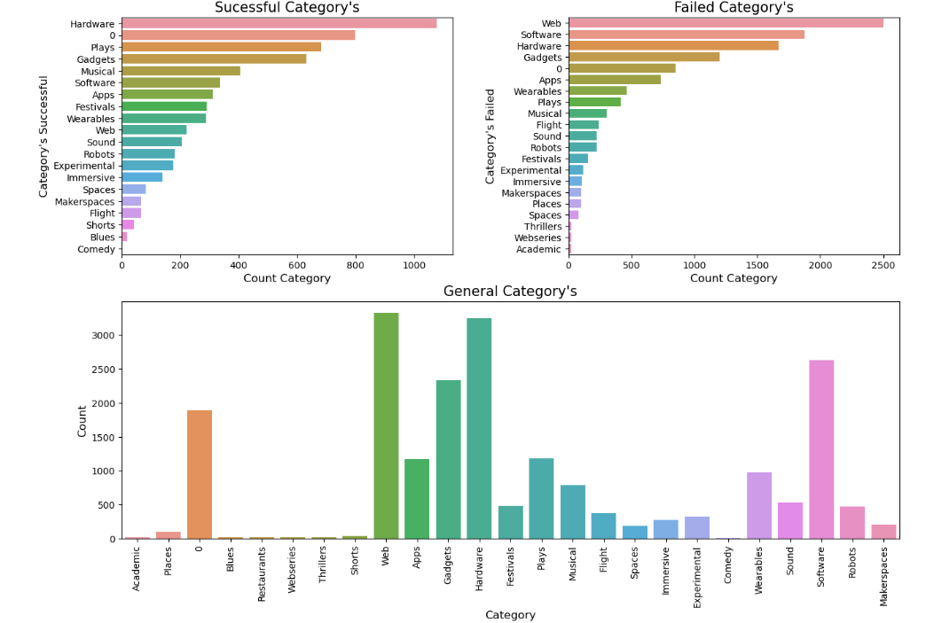
Distribution of “category” in terms of successful and failed

Slide 20
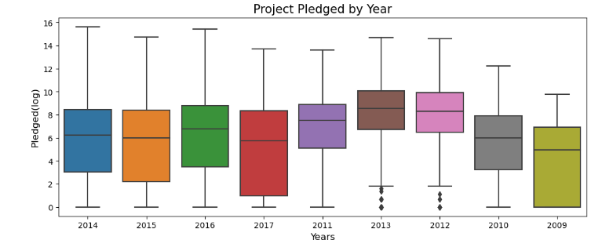
Pledged in terms of years

Slide 21
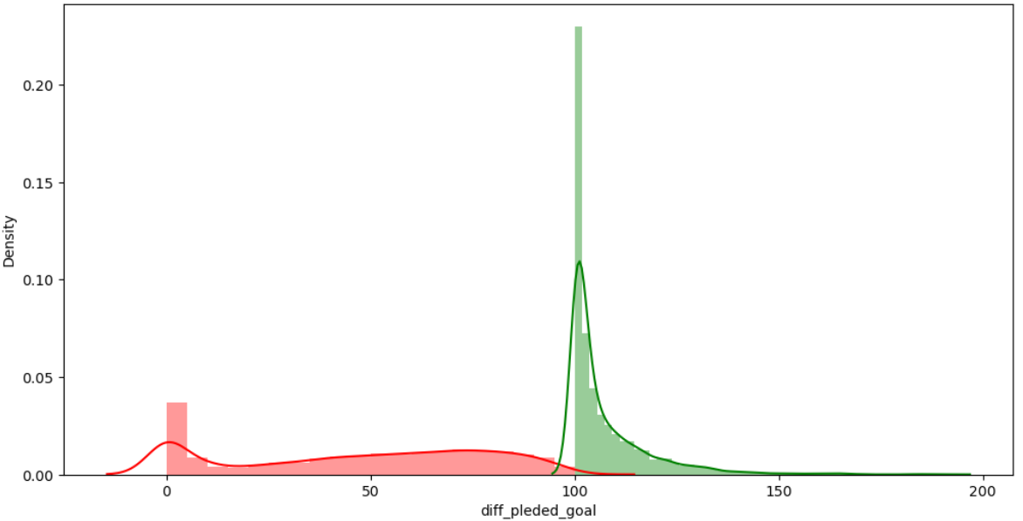
New feature calculates percentage of “pledged/goal”

Slide 22
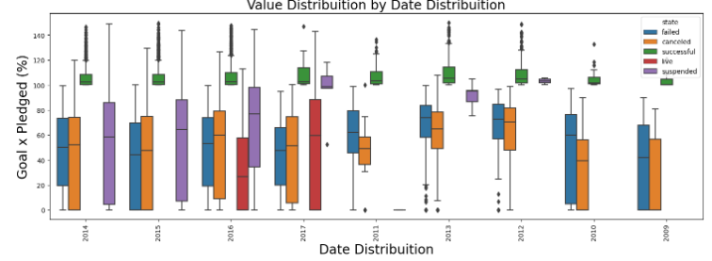
Goal X pledged in terms of Date distribution

Slide 23
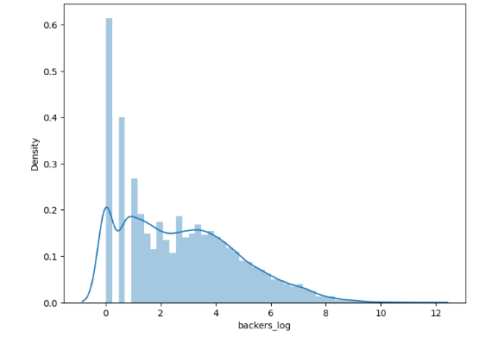
“Backers_count” in terms of logarithmic

Slide 24
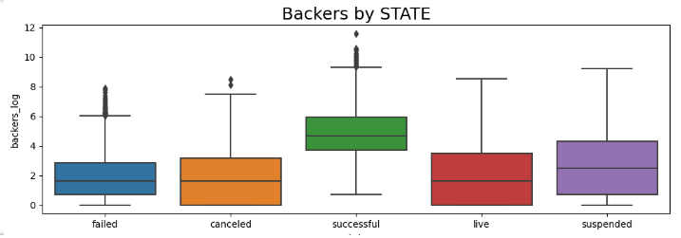
Backers in terms of “state”

Slide 25
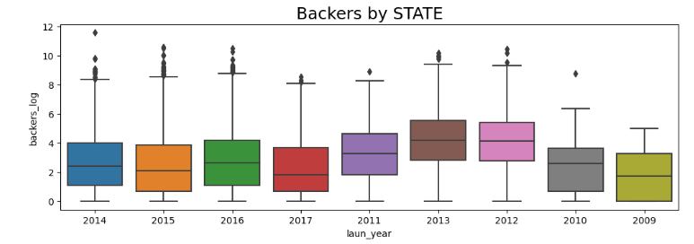
Backers w.r.t laun_year

Slide 26
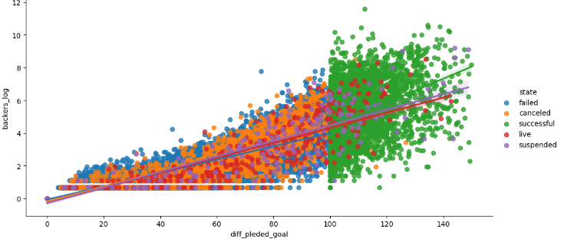
Relation of Backers and % of goal reached

Slide 27
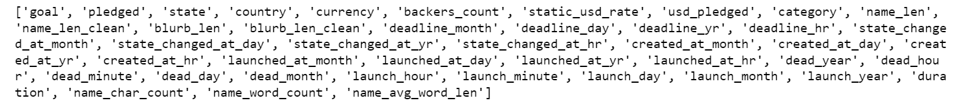
Final Dataset
final_preprocessed.csv
(20632, 43)

Slide 28
Training and Evaluation
Divided the dataset into train set and test set. Train set is 70% of the dataset and Test set is 30% of the dataset.
Used 3 models and compared the performances of those models.
The models that we used are:
Logistic Regression
Decision Tree Classifier
Gradient Boosting Decision Tree

Slide 29
Logistic Regression
Trained using ‘fit’ method with x_train and y_train as input
Predict method is used to predict labels for training and testing datasets and stored in y_train_pred, y_test_pred
Initialized with L2 Regularization which helps to prevent overfitting.

Slide 30
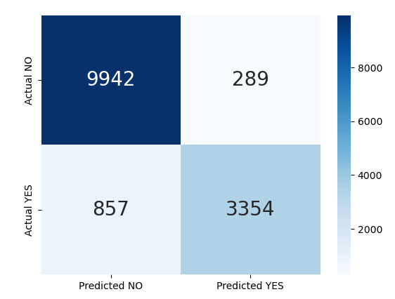
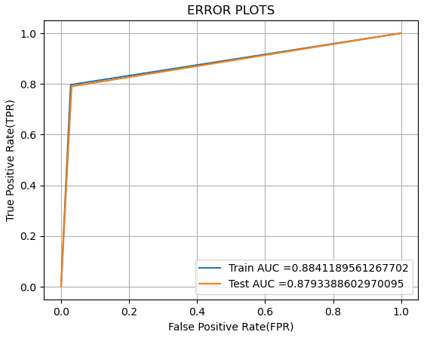
Logistic Regression
Accuracy: 92.03% Precision: 92.58% F1 Score: 85.40% Recall: 79.64%

Slide 31
Decision Tree Classifier
Used “batch_predict” function.
“Proba” classifier.
Hyperparameters: “min_samples_split” and “max_depth”.
Tuned hyperparameters using “GridSearchCV” function.
Performed 3-fold cross-validation to prevent overfitting.

Slide 32
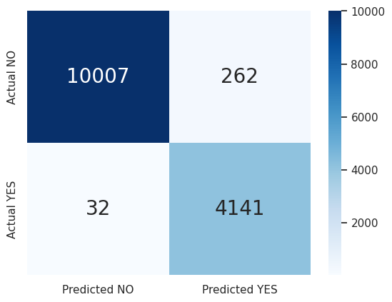
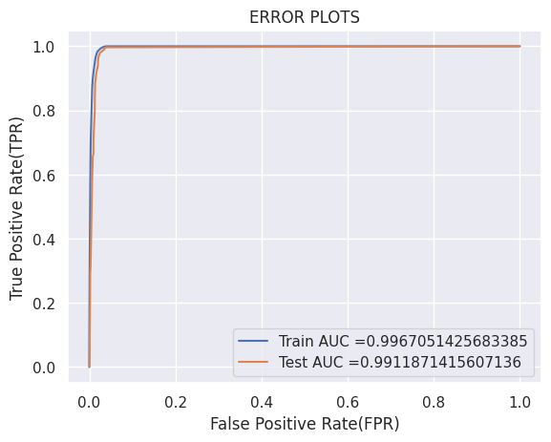
Decision Tree Classifier
Accuracy: 97.96% Precision: 94.04% F1 Score: 96.57% Recall: 99.23%

Slide 33
Gradient Boosting Decision Tree classifier
Combines multiple decision trees to improve predictive performance of model.
Hyperparameters : “max_depth” and “learning_rate”.
Used parameter “param_grid”.
Tuned hyperparameters using “GridSearchCV”.
Performed 3-fold cross-validation to prevent overfitting.

Slide 34
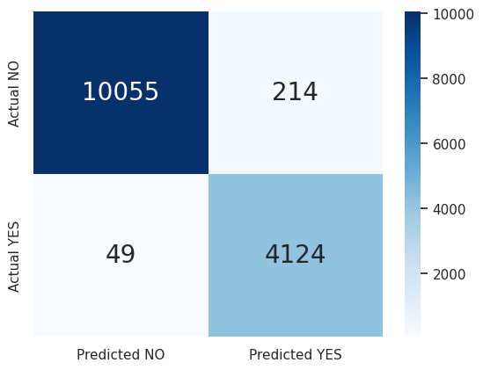
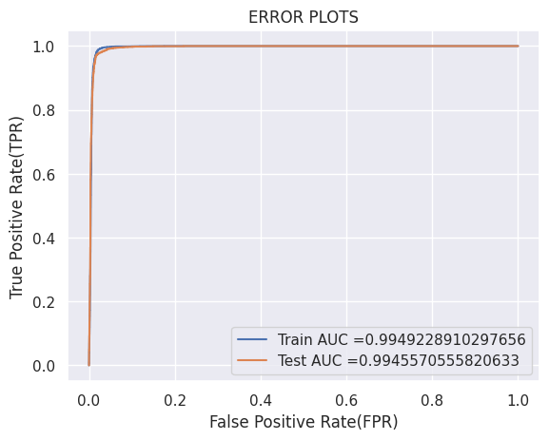
Gradient Boosting Decision Tree
Accuracy: 98.17% Precision: 95.06% F1 Score: 96.90% Recall: 98.82%

Slide 35
Results and Conclusion
The Gradient Boosting Classifier performed the best among all the models.
It gave an Accuracy of 98.17%, whereas, Decision Tree Classifier gave an Accuracy of 97.96%, and Logistic Regression gave an Accuracy of 92.03%.

Slide 36
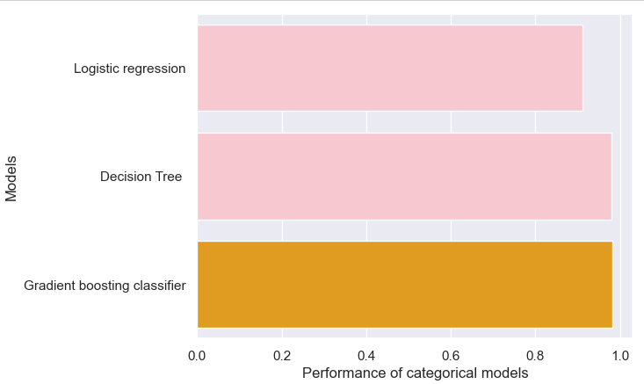
Results and Conclusion

Slide 37
THANK YOU!!

